Slide 1
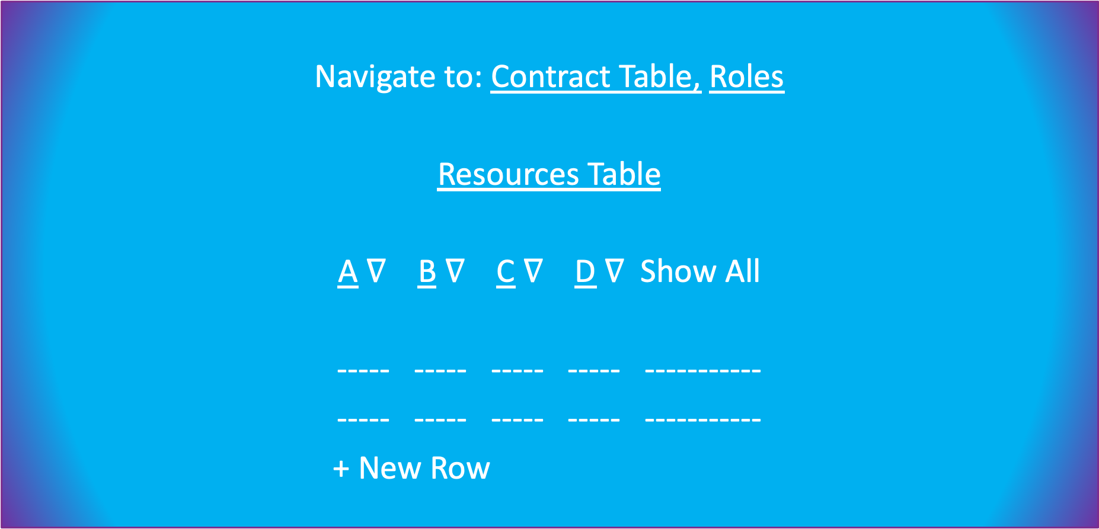
Navigate to: Contract Table, Roles
Resources Table
A $∇$ B $∇$ C $∇$ D $∇$ Show All
----- ----- ----- ----- -----------
----- ----- ----- ----- -----------
+ New Row

Slide 2
New Row
A* B* C* D …
---- ---- ---- --- --
* Means required
Save & Continue

Slide 3
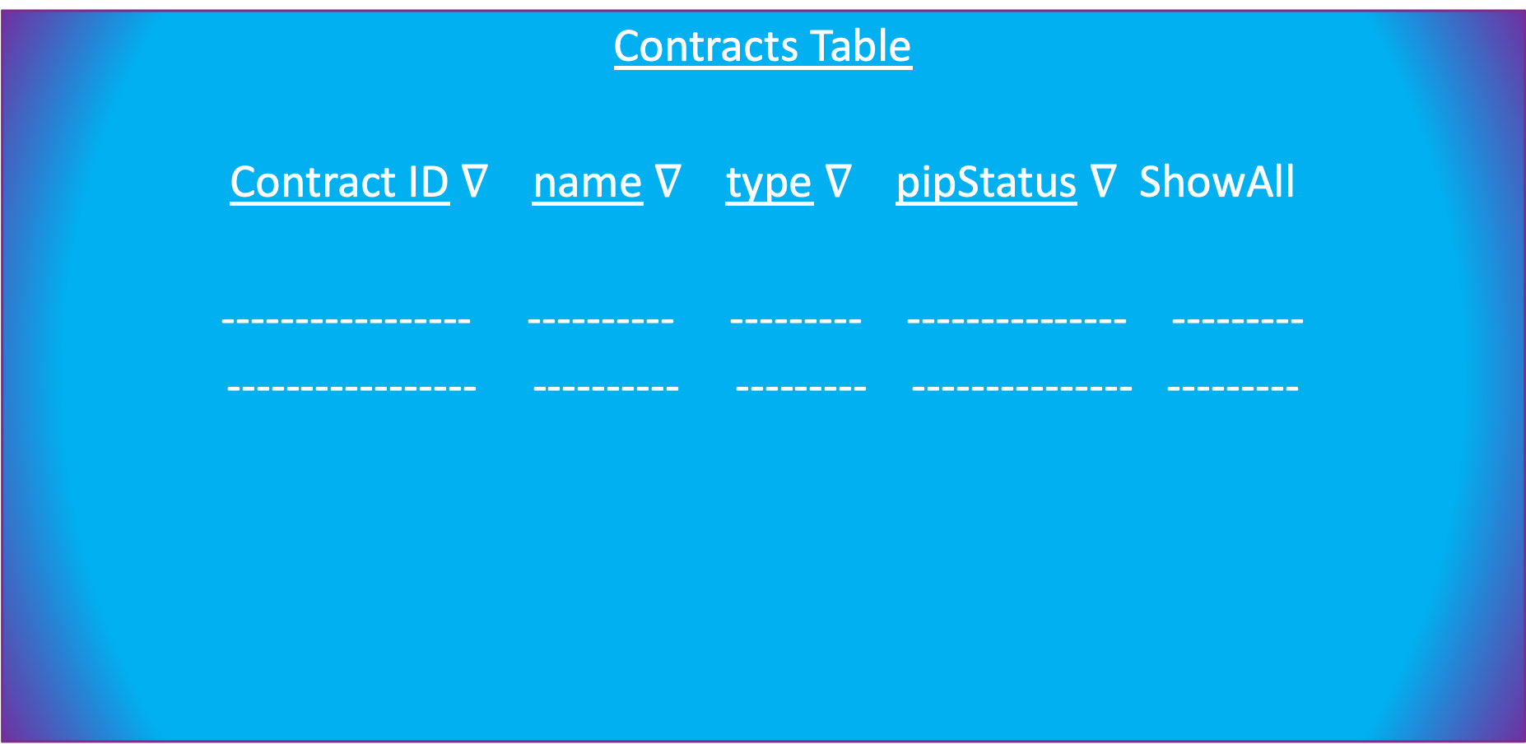
Contracts Table
Contract ID $∇$ name $∇$ type $∇$ pipStatus $∇$ ShowAll
----------------- ---------- --------- --------------- ---------
----------------- ---------- --------- --------------- ---------
Invoices
Resources
Roles

Slide 4
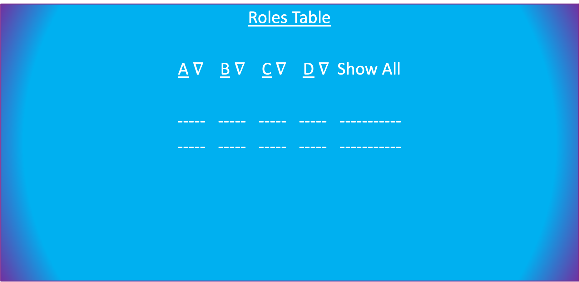
Roles Table
A $∇$ B $∇$ C $∇$ D $∇$ Show All
----- ----- ----- ----- -----------
----- ----- ----- ----- -----------
Contracts
Invoices
Resources

Slide 5
Improvements for the future: Data Scraper to manually import a lot of data (try it out if it’s simple)
Would like it to be intuitive, take inspiration

